Slide 1
Chapter 5-6: Advanced SQL

Slide 2
Outline
Functions and Procedural Constructs
Triggers
Advanced Aggregation Features

Slide 3
Extensions to SQL

Slide 4
Functions and Procedures
SQL:1999 supports functions and procedures
Functions/procedures can be written in SQL itself, or in an external programming language (e.g., C, Java).
Functions written in an external languages are particularly useful with specialized data types such as images and geometric objects.
Example: functions to check if polygons overlap, or to compare images for similarity.
Some database systems support table-valued functions, which can return a relation as a result.
SQL:1999 also supports a rich set of imperative constructs, including
Loops, if-then-else, assignment
Many databases have proprietary procedural extensions to SQL that differ from SQL:1999.

Slide 5
SQL Functions
Define a function that, given the name of a department, returns the count of the number of instructors in that department.
create function dept_count (dept_name varchar(20)) returns integer begin declare d_count integer; select count (* ) into d_count from instructor where instructor.dept_name = dept_name return d_count; end
The function dept_count can be used to find the department names and budget of all departments with more that 12 instructors.
select dept_name, budget from department where dept_count (dept_name ) > 12

Slide 6
SQL functions (Cont.)
Compound statement: begin … end
May contain multiple SQL statements between begin and end.
returns -- indicates the variable-type that is returned (e.g., integer)
return -- specifies the values that are to be returned as result of invoking the function
SQL function are in fact parameterized views that generalize the regular notion of views by allowing parameters.

Slide 7
Table Functions
SQL:2003 added functions that return a relation as a result
Example: Return all instructors in a given department
create function instructor_of (dept_name char(20))
returns table (
ID varchar(5), name varchar(20), dept_name varchar(20), salary numeric(8,2))
return table (select ID, name, dept_name, salary from instructor where instructor.dept_name = instructor_of.dept_name)
Usage
select * from table (instructor_of (‘Music’))

Slide 8
SQL Procedures
The dept_count function could instead be written as procedure:
create procedure dept_count_proc (in dept_name varchar(20), out d_count integer) begin
select count(*) into d_count from instructor where instructor.dept_name = dept_count_proc.dept_name
end
Procedures can be invoked either from an SQL procedure or from embedded SQL, using the call statement.
declare d_count integer; call dept_count_proc( ‘Physics’, d_count);
Procedures and functions can be invoked also from dynamic SQL
SQL:1999 allows more than one function/procedure of the same name (called name overloading), as long as the number of arguments differ, or at least the types of the arguments differ

Slide 9
Why Stored Procedures
Reduces Duplication of effort and improves software modularity
Multiple applications can use the stored procedure vs. the SQL statements being stored in the application language (PHP)
Reduces communication and data transfer cost between client and server (in certain situations)
Instead of sending multiple lengthy SQL statements, the application only has to send the name and parameters of the Stored Procedure
Can be more secure than SQL statements
Permission can be granted to certain stored procedures without granting access to database tables

Slide 10
Disadvantages of Stored Procedures
Difficult to debug
SQLServer/MySQL does not provide ways for debugging stored procedures
Many stored procedures can increase memory use
The more stored procedures you use, the more memory is used
Can be difficult to maintain and develop stored procedures
Another programming language to learn

Slide 11
Creating Stored Procedures
DELIMITER //
CREATE PROCEDURE name
BEGIN
SQL STATEMENT
END //
DELIMITER ;
DELIMITER //
CREATE PROCEDURE GetAllProducts()
BEGIN
SELECT * FROM products;
END //
DELIMITER ;

Slide 12
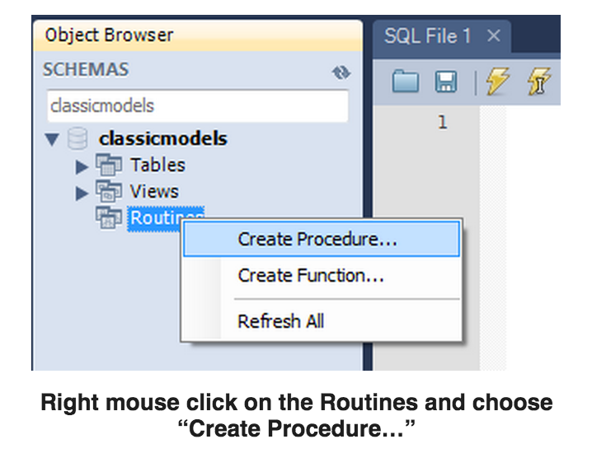
Stored Procedure in Workbench

Slide 13
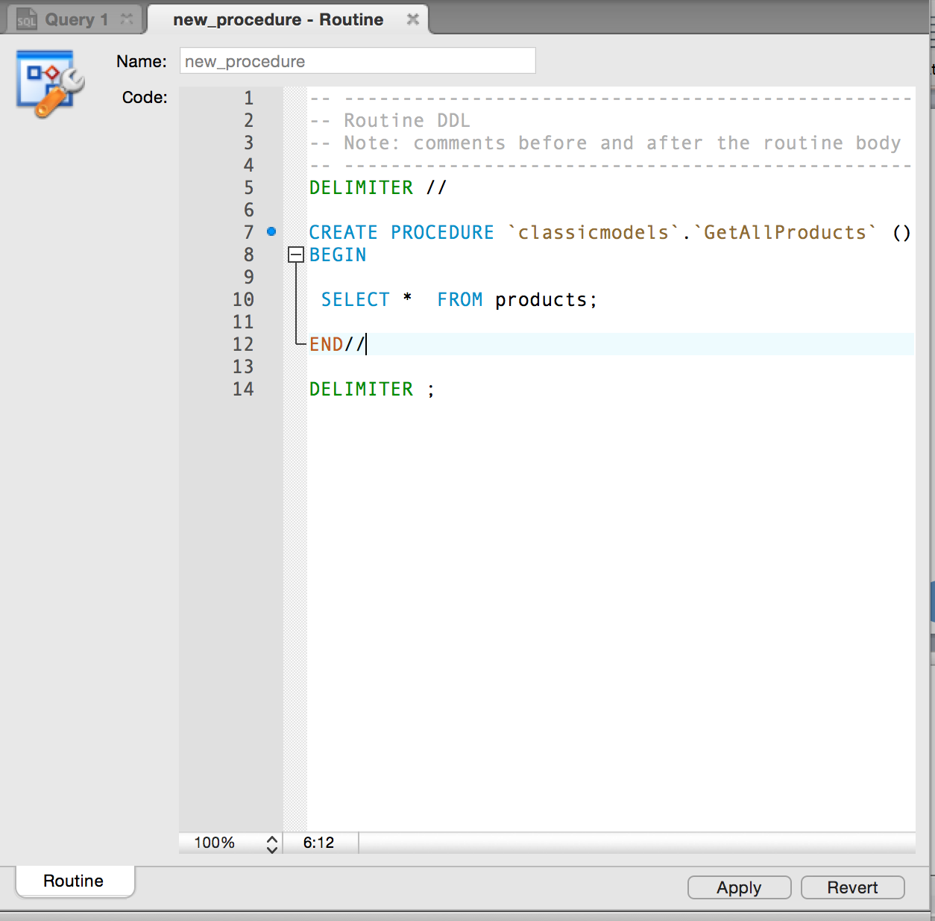
Stored Procedure in Workbench

Slide 14
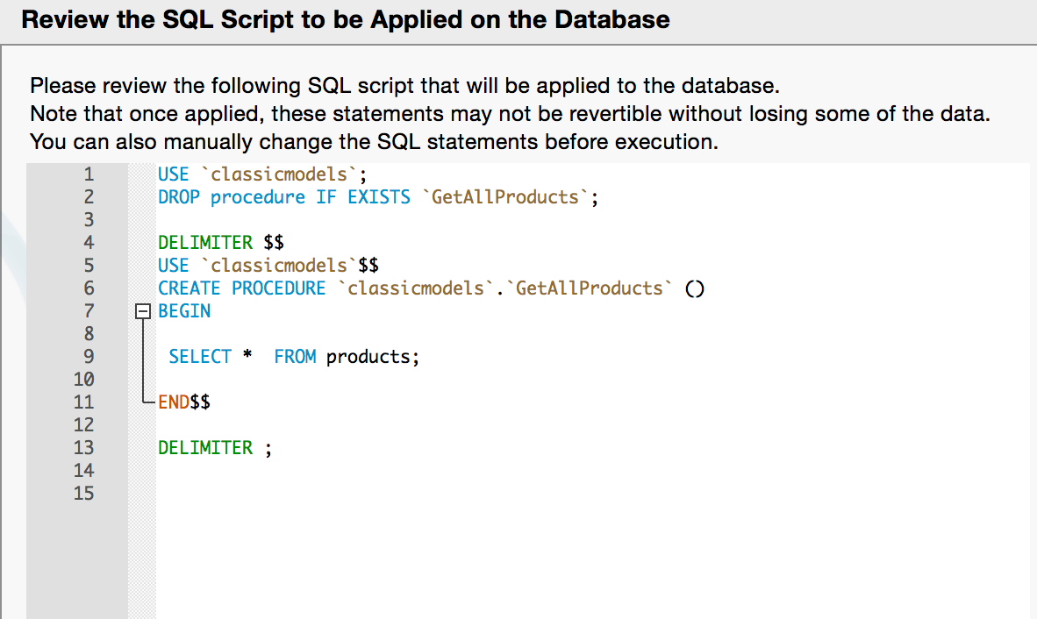

Slide 15
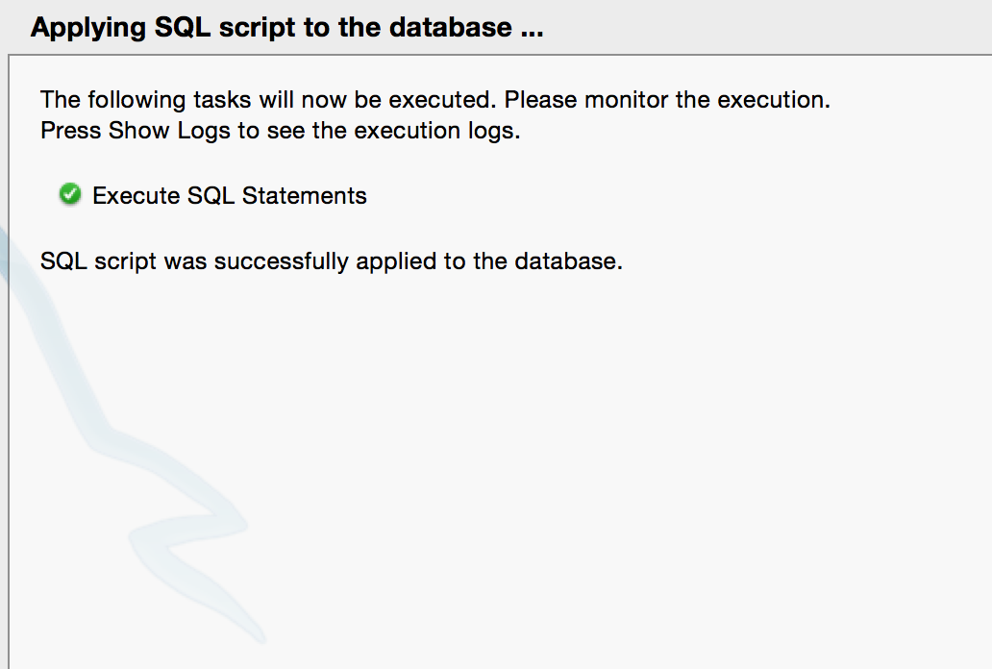

Slide 16
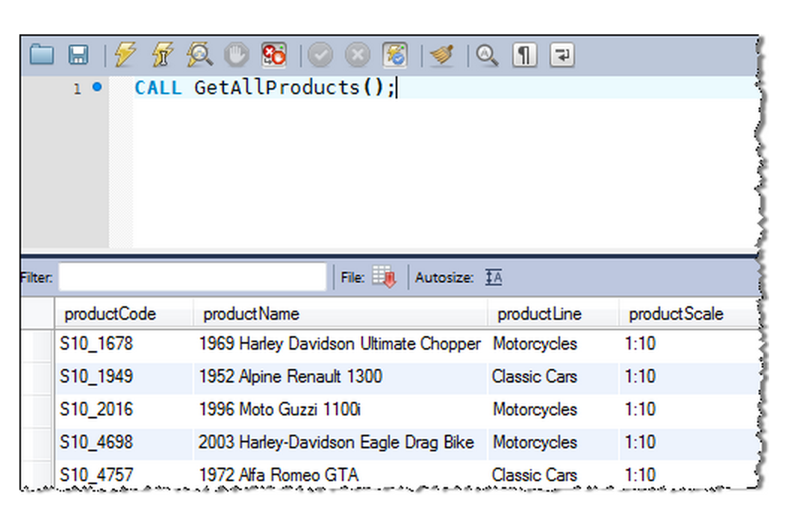

Slide 17
Calling Stored Procedures
CALL STORED_PROCEDURE_NAME
CALL GetAllProducts();

Slide 18
Language Constructs for Procedures & Functions
SQL supports constructs that gives it almost all the power of a general-purpose programming language.
Warning: most database systems implement their own variant of the standard syntax below.
Compound statement: begin … end,
May contain multiple SQL statements between begin and end.
Local variables can be declared within a compound statements
While and repeat statements:
while boolean expression do
sequence of statements ;
end while
repeat
sequence of statements ;
until boolean expression
end repeat

Slide 19
Language Constructs (Cont.)
For loop
Permits iteration over all results of a query
Example: Find the budget of all departments declare n integer default 0; for r as select budget from department do set n = n + r.budget end for

Slide 20
Language Constructs (Cont.)
Conditional statements (if-then-else) SQL:1999 also supports a case statement similar to C case statement
Example procedure: registers student after ensuring classroom capacity is not exceeded
Returns 0 on success and -1 if capacity is exceeded
See book (page 177) for details
Signaling of exception conditions, and declaring handlers for exceptions
declare out_of_classroom_seats condition declare exit handler for out_of_classroom_seats begin … .. signal out_of_classroom_seats end
The handler here is exit -- causes enclosing begin..end to be exited
Other actions possible on exception

Slide 21
External Language Routines
SQL:1999 permits the use of functions and procedures written in other languages such as C or C++
Declaring external language procedures and functions
create procedure dept_count_proc(in dept_name varchar(20), out count integer) language C external name ’ /usr/avi/bin/dept_count_proc’ create function dept_count(dept_name varchar(20)) returns integer language C external name ‘/usr/avi/bin/dept_count’

Slide 22
External Language Routines
SQL:1999 allows the definition of procedures in an imperative programming language, (Java, C#, C or C++) which can be invoked from SQL queries.
Functions defined in this fashion can be more efficient than functions defined in SQL, and computations that cannot be carried out in SQL can be executed by these functions.
Declaring external language procedures and functions
create procedure dept_count_proc(in dept_name varchar(20), out count integer) language C external name ’ /usr/avi/bin/dept_count_proc’ create function dept_count(dept_name varchar(20)) returns integer language C external name ‘/usr/avi/bin/dept_count’

Slide 23
External Language Routines (Cont.)
Benefits of external language functions/procedures:
more efficient for many operations, and more expressive power.
Drawbacks
Code to implement function may need to be loaded into database system and executed in the database system’s address space.
risk of accidental corruption of database structures
security risk, allowing users access to unauthorized data
There are alternatives, which give good security at the cost of potentially worse performance.
Direct execution in the database system’s space is used when efficiency is more important than security.

Slide 24
Security with External Language Routines
To deal with security problems, we can do on of the following:
Use sandbox techniques
That is, use a safe language like Java, which cannot be used to access/damage other parts of the database code.
Run external language functions/procedures in a separate process, with no access to the database process’ memory.
Parameters and results communicated via inter-process communication
Both have performance overheads
Many database systems support both above approaches as well as direct executing in database system address space.

Slide 25
Advanced Aggregation Features

Slide 26
Ranking
Ranking is done in conjunction with an order by specification.
Suppose we are given a relation student_grades(ID, GPA) giving the grade-point average of each student
Find the rank of each student.
select ID, rank() over (order by GPA desc) as s_rank from student_grades
An extra order by clause is needed to get them in sorted order
select ID, rank() over (order by GPA desc) as s_rank from student_grades order by s_rank
Ranking may leave gaps: e.g. if 2 students have the same top GPA, both have rank 1, and the next rank is 3
dense_rank does not leave gaps, so next dense rank would be 2
Notes:
26

Slide 27
Ranking
Ranking can be done using basic SQL aggregation, but resultant query is very inefficient
select ID, (1 + (select count(*) from student_grades B where B.GPA > A.GPA)) as s_rank from student_grades A order by s_rank;

Slide 28
Ranking (Cont.)
Ranking can be done within partition of the data.
“Find the rank of students within each department.”
select ID, dept_name, rank () over (partition by dept_name order by GPA desc) as dept_rank from dept_grades order by dept_name, dept_rank;
Multiple rank clauses can occur in a single select clause.
Ranking is done after applying group by clause/aggregation
Can be used to find top-n results
More general than the limit n clause supported by many databases, since it allows top-n within each partition

Slide 29
Ranking (Cont.)
Other ranking functions:
percent_rank (within partition, if partitioning is done)
cume_dist (cumulative distribution)
fraction of tuples with preceding values
row_number (non-deterministic in presence of duplicates)
SQL:1999 permits the user to specify nulls first or nulls last
select ID, rank ( ) over (order by GPA desc nulls last) as s_rank from student_grades
Notes:
29

Slide 30
Ranking (Cont.)
For a given constant n, the ranking the function ntile(n) takes the tuples in each partition in the specified order, and divides them into n buckets with equal numbers of tuples.
E.g.,
select ID, ntile(4) over (order by GPA desc) as quartile from student_grades;
Notes:
30

Slide 31
End of Chapter 6

